Slide 1
Predicting Future NFL Hall of Famers
By: Sam Binenfeld

Slide 2
Introduction
What is the goal of this project?
To predict which NFL players will be inducted into the Hall of Fame in the near future.
How do we achieve our goal?
Acquire data from Kaggle.com and www.pro-football-reference.com
Explore the data to find out what qualifies players to be in the HOF
Create a model that can predict the likelihood that a player will be in the HOF
Run our model on current NFL Players, and players that retired after 2005

Slide 3
Project Restrictions
We only include players of the following positions:
Quarterback
Running Back
Wide Receiver
We restrict our training model to include only players whose career started after 1960, and ended before 2006.

Slide 4
Data Acquisition
The core source of our data comes from the Kaggle dataset NFL Statistics
We collect the three tables we want: Passing, Rushing, and Receiving
We merge these three tables together, so that we have one table with all of our information
We bring in more data from another source, www.pro-football-reference.com
We get 6 supplemental tables, and merge them with our initial dataset
Hall of Famers
Super Bowls
Game-Winning Drives
Playoff Game-Winning Drives
MVPs
Super Bowl MVPs

Slide 5
Data Cleaning
Remove Text
Some of the number fields have text mixed in with them
Fix Position Column: Remove Nulls and Reformat
To fill these nulls, we create a function that is able to determine the player’s position.
The function looks at passing yards, rushing yards, and receiving yards, and determines which is the highest.
It then assigns the player a position of quarterback (0), running back (1), or wide receiver (2)

Slide 6
Data Pre-Processing
Create New Columns
Create columns for a player’s first and last year in the league
Adjust the following statistics for inflation:
Passing Yards
TD Passes
Rushing Yards
Rushing TDs
Receiving Yards
Receiving TDs
Create Combined Feature Variables
SB - Total Superbowls (Super Bowl Wins + Super Bowl Losses)
RRYd – Receiving Yards + Rushing Yards
RRTD - Receiving Touchdowns + Rushing Touchdowns

Slide 7
Data Pre-Processing
Transform the Data
Pivot the data to convert from yearly stats to career stats
Recalculate Ratio Columns
Passing Yards Per Game – Passing Yards / Games Played
Completion Percentage – Passes Completed / Passes Attempted
Yards Per Carry – Rushing Yards / Rushing Attempts
Lasso (L1 Regularization)
We use the Lasso method (at ⍺ = .01) to perform feature selection
We reduce our number of features from 52 to 14

Slide 8
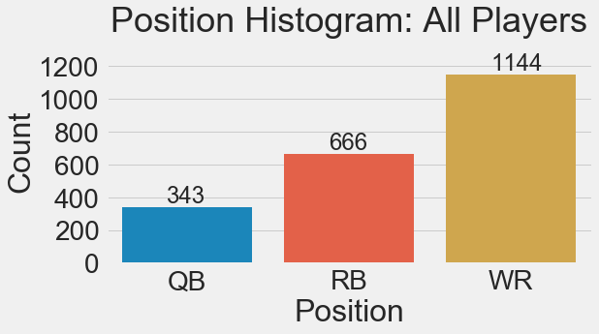
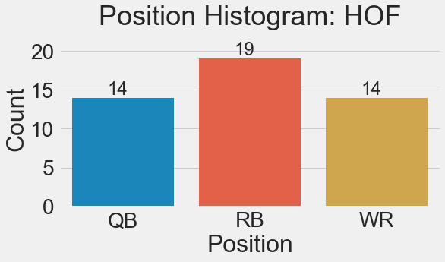
Data Exploration
Introduction to the Cleaned Dataset
Our cleaned dataset consists of 2,153 rows and 14 columns
Of the 2,153 players, only 47 of them are in the Hall of Fame (2.1%)
Position Distribution

Slide 9
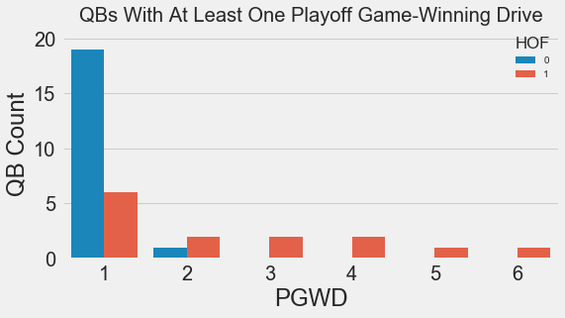
Data Exploration: Quarterbacks
For quarterbacks, the variable that has the highest correlation with Hall of Fame is Playoff Game-Winning Drives.
We can look at a histogram of quarterbacks with at least one Playoff Game-Winning Drive
All HOF quarterbacks have at least one PGWD.
All quarterbacks with more than 2 PGWDs are in the HOF.

Slide 10
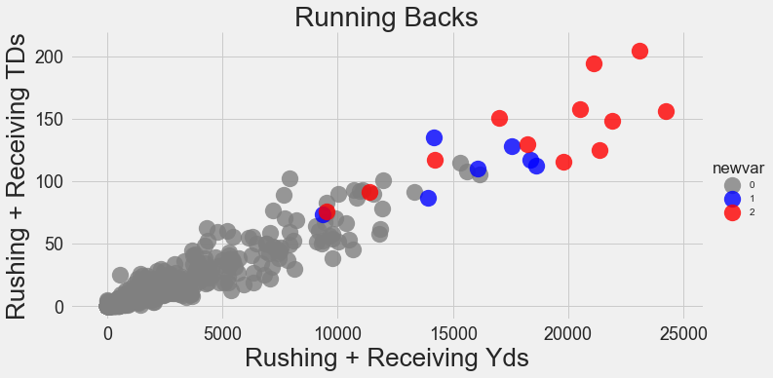
Data Exploration: Running Backs
13 running backs have won either a League MVP or a Super Bowl MVP (3 have won both).
12 out of these 13 MVP are in the HOF
Red | HOF Running Backs with at least one MVP (Super Bowl or League MVP)
Blue | HOF Running Backs without an MVP award
Gray | Non-HOF Running Backs

Slide 11
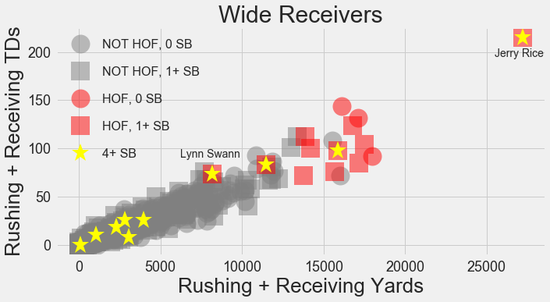
Data Exploration: Wide Receivers
In this plot, HOF Wide Receivers are in red
Squares represent someone who has been to at least one Super Bowl
Shapes with a gold star in the middle show a player who has been to 4 or more Super Bowls

Slide 12
Modeling
The algorithms we will test are:
Random Forest
Logistic Regression
Support Vector Classifier
Gradient Boosting
The resampling methods we will test are:
Random Over Sampling
SMOTE
Random Under Sampler
We will use F1 score as our Performance Metric

Slide 13
Modeling: Variables
Our response variable is HOF (Hall of Fame)
Our predictor variables are:
SB MVP
RRTD
Receiving Yards Per Game
MVP, Rushing Yards adj
PGWD
TD Passes adj
RRYd
Passing Yards Per Game
SB
SB Win
Position

Slide 14
Modeling: Initial Testing
Classifier | Sampler | Accuracy | F1 | Precision | Recall
GradientBoosting Classifier | nosampler | 0.993321 | 0.824689 | 0.87056 | 0.803636
 | SMOTE | 0.990538 | 0.812408 | 0.797711 | 0.842179
 | RandomOverSampler | 0.991095 | 0.805656 | 0.799634 | 0.82599
RandomForest Classifier | nosampler | 0.992022 | 0.785662 | 0.905429 | 0.699957
LogisticRegression | nosampler | 0.989239 | 0.770769 | 0.844451 | 0.71984
RandomForest Classifier | RandomOverSampler | 0.98961 | 0.756497 | 0.780022 | 0.746907
 | SMOTE | 0.988312 | 0.738019 | 0.791825 | 0.709014
GradientBoosting Classifier | RandomUnderSampler | 0.960297 | 0.554085 | 0.401329 | 0.954762
RandomForest Classifier | RandomUnderSampler | 0.956401 | 0.549563 | 0.392505 | 0.993333
LogisticRegression | SMOTE | 0.956401 | 0.486309 | 0.334287 | 0.984615
 | RandomOverSampler | 0.948237 | 0.420189 | 0.269592 | 1
 | RandomUnderSampler | 0.926345 | 0.358347 | 0.224078 | 0.977381
SVC | SMOTE | 0.44026 | 0.072452 | 0.037694 | 1
 | RandomUnderSampler | 0.187384 | 0.050136 | 0.025757 | 1
 | RandomOverSampler | 0.97885 | 0 | 0 | 0
 | nosampler | 0.980519 | 0 | 0 | 0

Slide 15
Modeling: Parameter Tuning
Gradient Boosting algorithm was our best performer
The left table shows the values tested for each parameter
The right table shows the optimal value for each parameter
Hyper-Parameter | Values Tested
'max_depth' | [5, 6, 7, 8],
'max_features' | [0.1, 0.2, 0.3, 0.4],
'min_samples_leaf' | [5, 10, 20, 50],
'min_samples_split' | [0.05, 0.075, 0.1],
'subsample' | [0.5, 0.75, 0.9, 1]
Hyper-Parameter | Optimal Value
'max_depth' | 7
'max_features' | 0.2
'min_samples_leaf' | 5
'min_samples_split' | 0.1
'subsample' | 0.9

Slide 16
Modeling: Optimal Model
We re-run the Gradient-Boosting algorithm with optimal parameters
We find the best re-sampling method is the Random Over Sampler
Classifier | Sampler | Accuracy | F1 | Precision | Recall
GradientBoosting Classifier | Random Over-Sampler | 0.994286 | 0.875867 | 0.841344 | 0.922296
 | nosampler | 0.992764 | 0.833550 | 0.875636 | 0.807443
 | SMOTE | 0.992393 | 0.832843 | 0.765702 | 0.925740
 | Random Under-Sampler | 0.963636 | 0.560210 | 0.401982 | 0.983445

Slide 17
Results: Future Hall of Famers
We take our trained model, and make predictions on current NFL players, and players who retired in 2006 or later
Our model performs well, as it correctly predicted all four players who have been inducted to the Hall (highlighted in green)

Slide 18
Conclusion
We are happy to have created a model that is able to classify a test set with 99.4% accuracy, 84% precision, and 92% recall.
Future study could leverage other data sources to predict Hall of Famers in the many other NFL positions
We could improve our model by acquiring other relevant data and statistics (ex: # of Pro-Bowl Teams)

Slide 19
Appendix: Variables Used in Modeling
Columns | Data Type | Description
RRTD | float64 | Rushing TDs adj + Receiving TDs adj
SB MVP | float64 | Super Bowl MVP awards
Receiving Yards Per Game | float64 | Receiving Yards adj / Games Played
Rushing Yards adj | float64 | Rushing Yards adjusted for inflation
MVP | float64 | Most Valuable Player Awards won
PGWD | float64 | Playoff Game-Winning Drives
TD Passes adj | float64 | TD Passes adjusted for inflation
RRYd | float64 | Receiving Yards adj + Rushing Yards adj
Passing Yards Per Game | float64 | Passing Yards adj / Games Played
SB | float64 | Super Bowl Appearances
Name | object | Player’s Name
Player Id | object | Individual Identifier
HOF | int64 | Hall of Fame Status 1 – In Hall of Fame 0 – Not in Hall of Fame
Position | int64 | 0- Quarterback 1- Running Back 2- Wide Receiver

Slide 20
Appendix: All Variables
Columns | Data Type | Columns | Data Type | Columns | Data Type | Columns | Data Type
Player Id | object | Passes Attempted | float64 | Receptions Longer than 20 Yards | float64 | Sacks | float64
Name | object | Passes Completed | float64 | Receptions Longer than 40 Yards | float64 | TD Passes adj | float64
Position | int64 | Passes Longer than 20 Yards | float64 | Rushing Attempts | float64 | Yards Per Carry | float64
Completion Percentage | float64 | Passes Longer than 40 Yards | float64 | Rushing Attempts Per Game | float64 | Yards Per Reception | float64
First Down Receptions | float64 | Passing Yards Per Attempt | float64 | Rushing First Downs | float64 | Year | float64
First Year | int64 | Passing Yards Per Game | float64 | Rushing More Than 20 Yards | float64 | MVP | float64
Games Played | float64 | Passing Yards adj | float64 | Rushing More Than 40 Yards | float64 | SB MVP | float64
HOF | int64 | Percentage of Rushing First Downs | float64 | Rushing TDs adj | float64 | GWD | float64
Int Rate | float64 | Percentage of TDs per Attempts | float64 | Rushing Yards Per Game | float64 | PGWD | float64
Ints | float64 | Receiving TDs adj | float64 | Rushing Yards adj | float64 | SB | float64
Last Year | int64 | Receiving Yards Per Game | float64 | SB Loss | float64 | RRYd | float64
Pass Attempts Per Game | float64 | Receiving Yards adj | float64 | SB Win | float64 | RRTD | float64
Passer Rating | float64 | Receptions | float64 | Sacked Yards Lost | float64

Slide 21

Appendix: Inflation Calculation
adj: means that metric is adjusted for inflation
inflation calculation: $\frac{a}{ b}=c$
$a=Mean of the top 15 players in year 2016$
$b=Mean of the top 15 players in current year$
$c=Inflation Multiplier (this is multiplied by the original value)$

